Slide 1

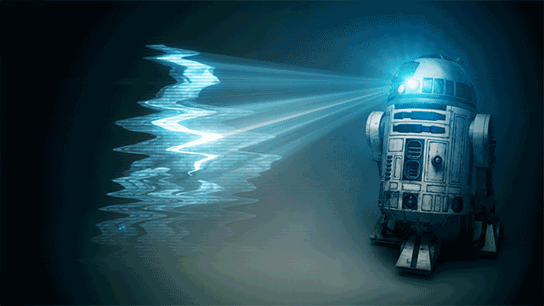


“HOLOMANIAC”

Slide 2
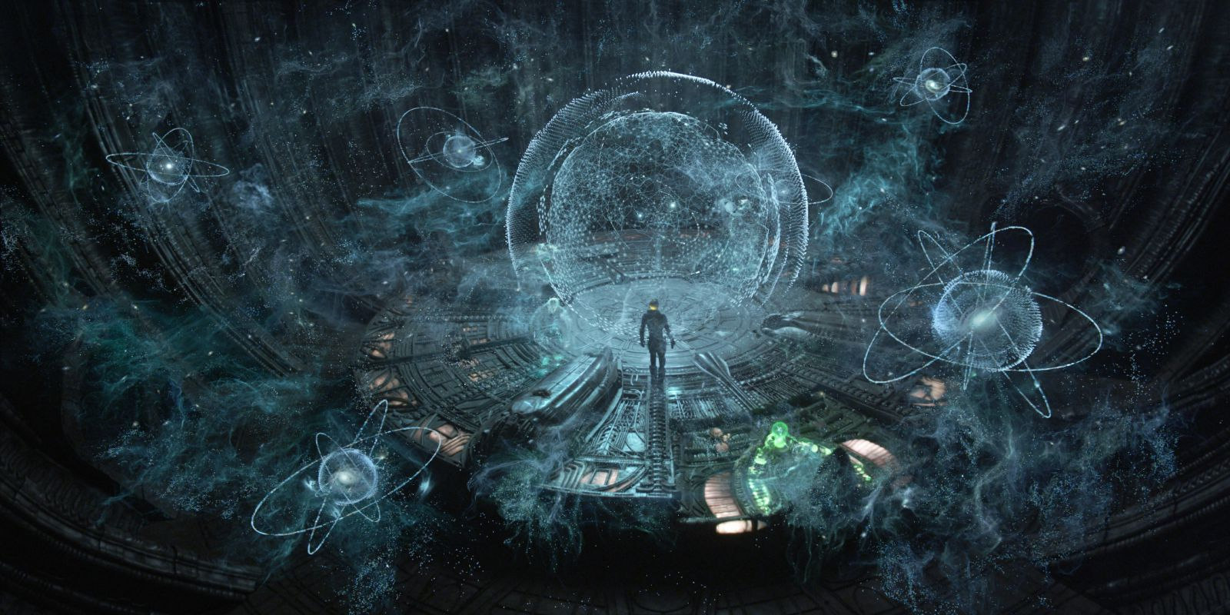
HOLOGRAM

Slide 3
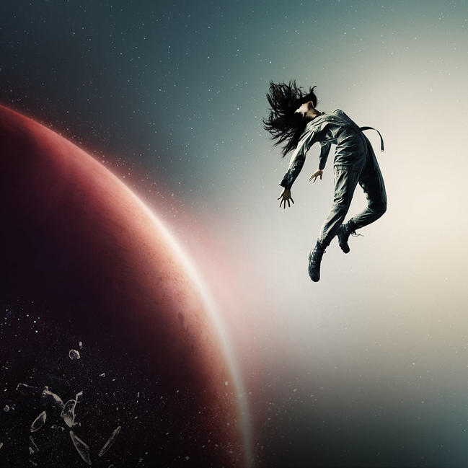
SCI-FI...!!!!!

Slide 4


Slide 5
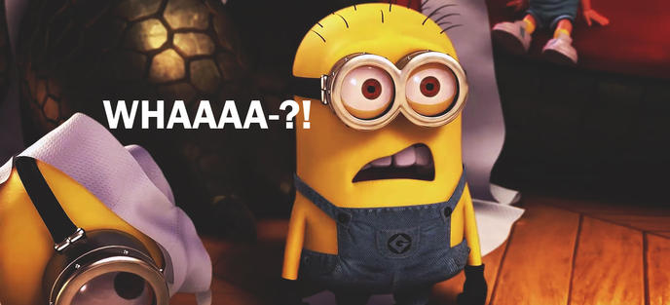

Slide 6


Slide 7

They're sort of "photographic ghosts"

Slide 8
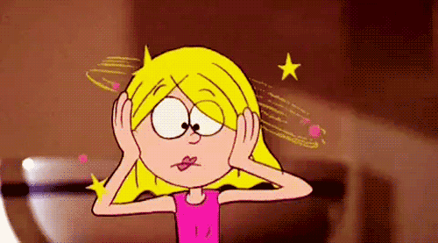
STILL CONFUSE????

Slide 9

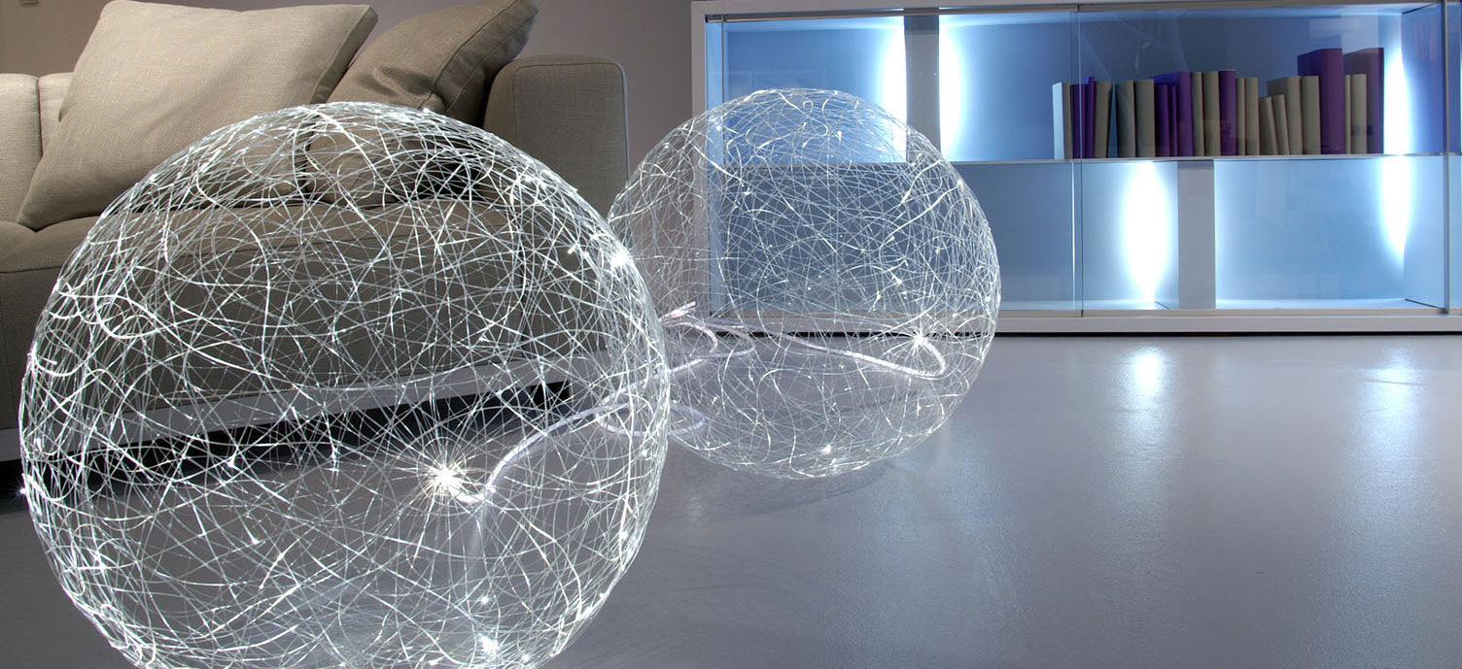
OPTICS

Slide 10
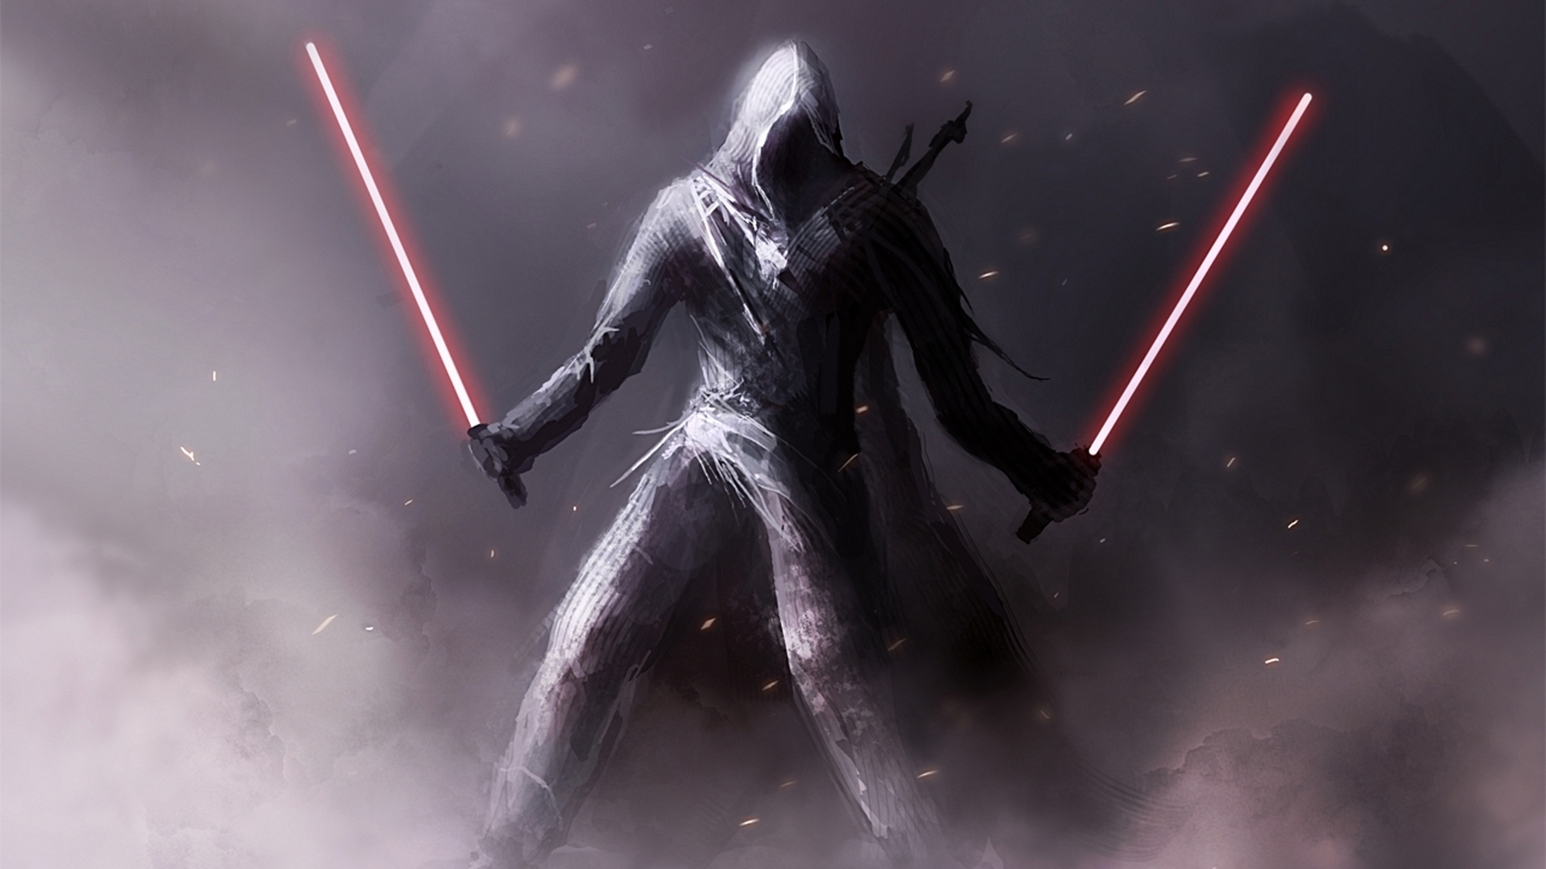
How does hologram actually work??
It works on two concepts: INTERFERNCE and DIFFRACTION

Slide 11
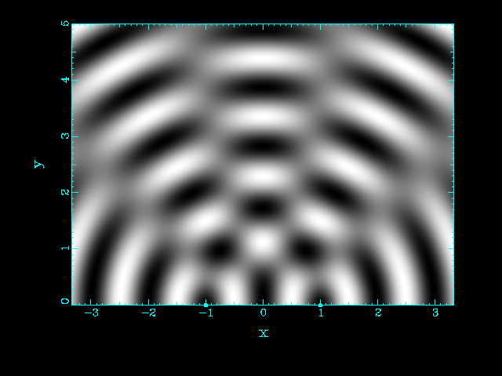
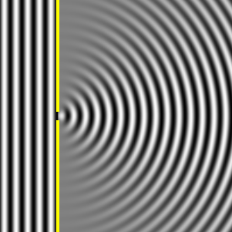
Interference
The process in which two or more light, sound, or electromagnetic waves of the same frequency combine to reinforce or cancel each other, the amplitude of the resulting wave being equal to the sum of the amplitudes of the combining waves.

Slide 13
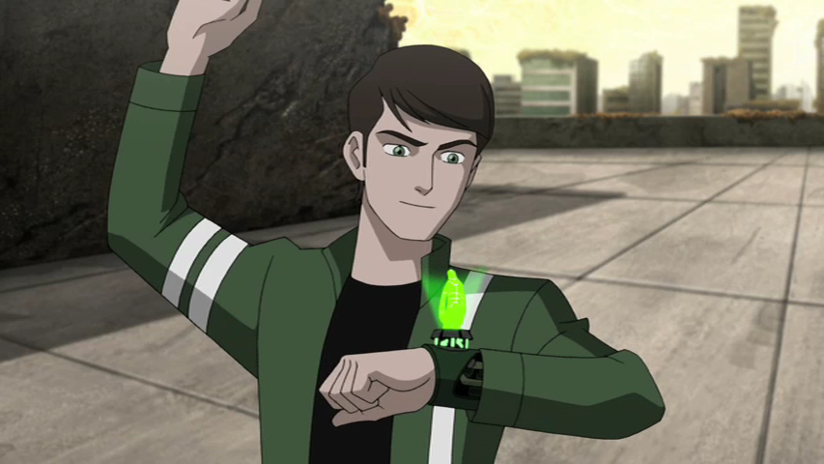
SETTING UP A HOLOGRAM..!!
READY..???

Slide 15
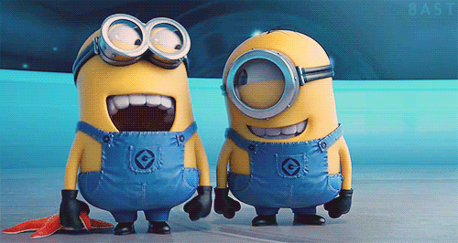

Slide 17
Applications
Of
holography

Slide 19
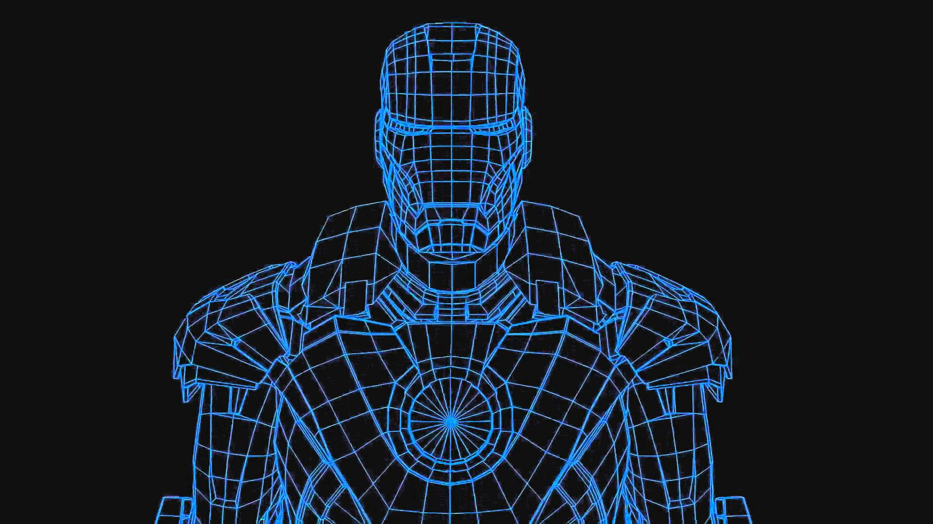
DATA COMPRESSION
Lossy compression through quantization of both the real and imaginary streams, followed by a bit packing operation

Slide 20
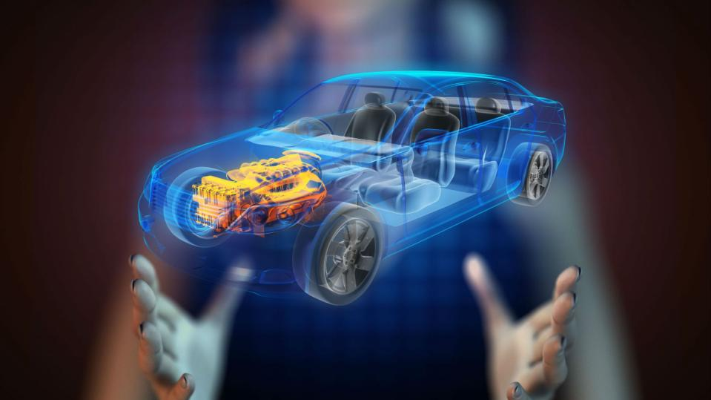
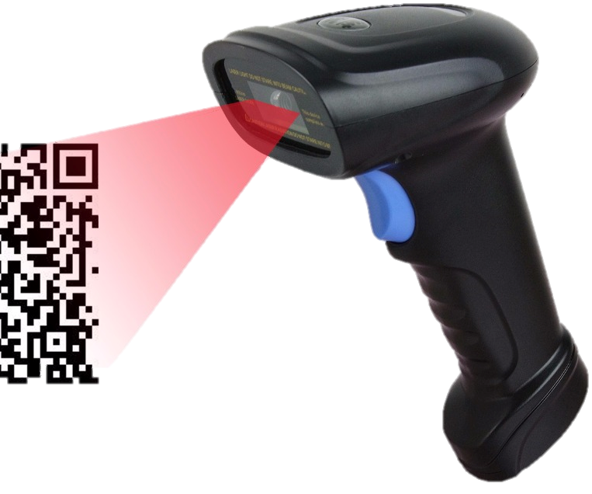
HOLOGRAPHIC SCANNERS
A type of scanner in which a lazer is deflected by a rotating hologram so that it scans a plane in a multitude of directions and brought to focus on a sensor
Eg:- reading bar codes at retail checkouts.

Slide 21
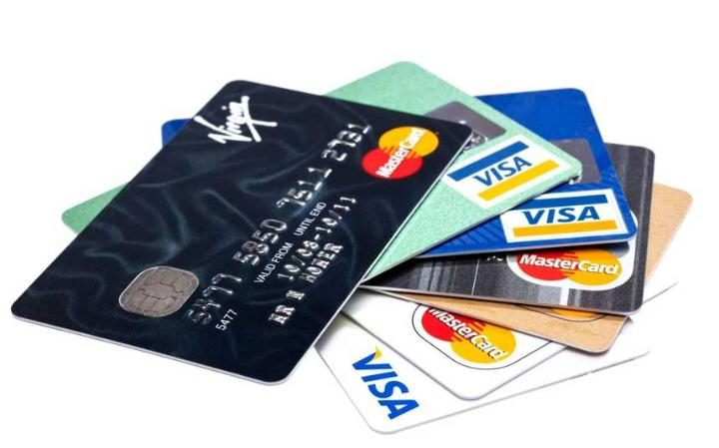
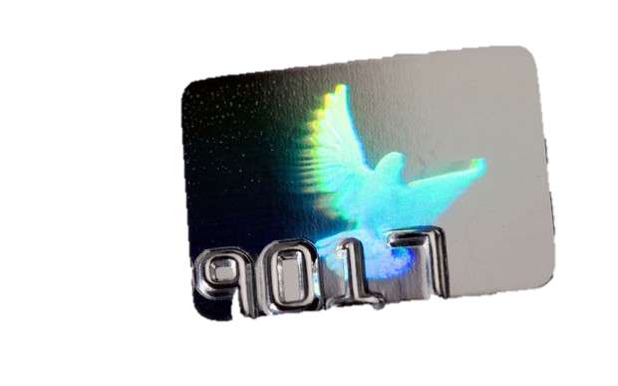
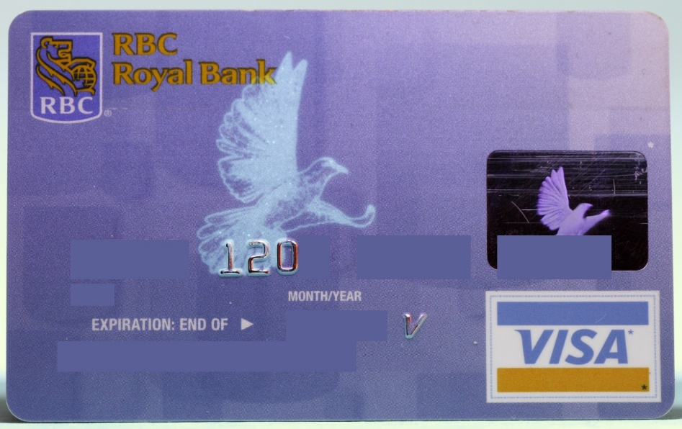
Security in credit cards
high security features like micro texts, nano texts, complex images, logos and a multitude of other features can be integrated.
Holograms once affixed on Debit cards/passports cannot be removed easily. They offer an individual identity to a brand along with its protection.

Slide 22
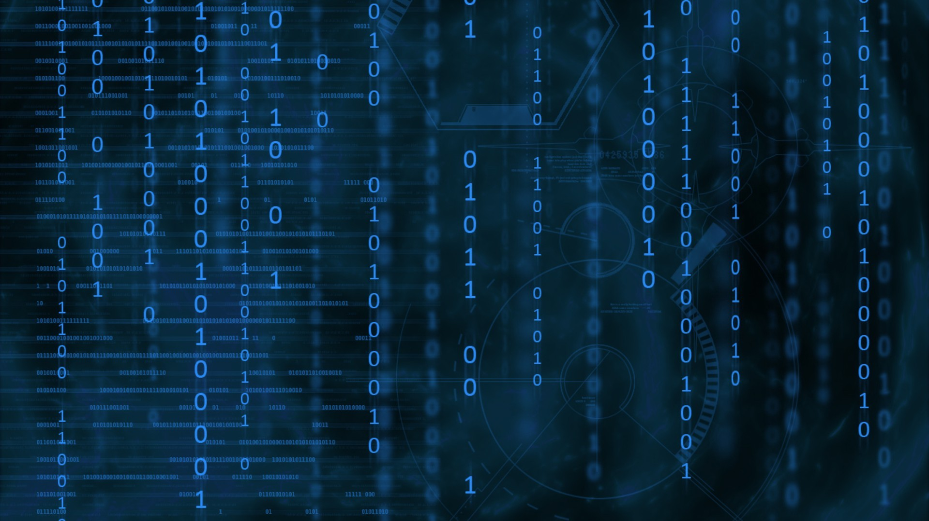
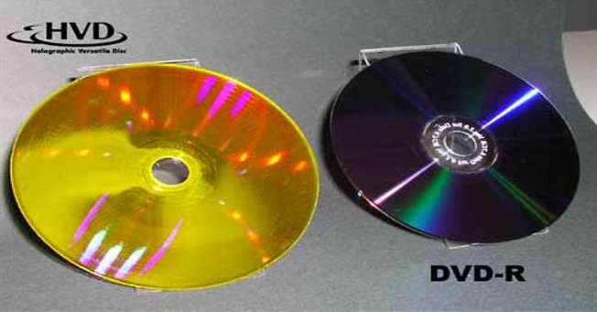
DATA STORAGE
technique that can store information at high density inside crystals or photopolymers
The ability to store large amounts of information in some kind of medium is of great importance
It’s the future of DVD’s ,Blu-rays etc.

Slide 23
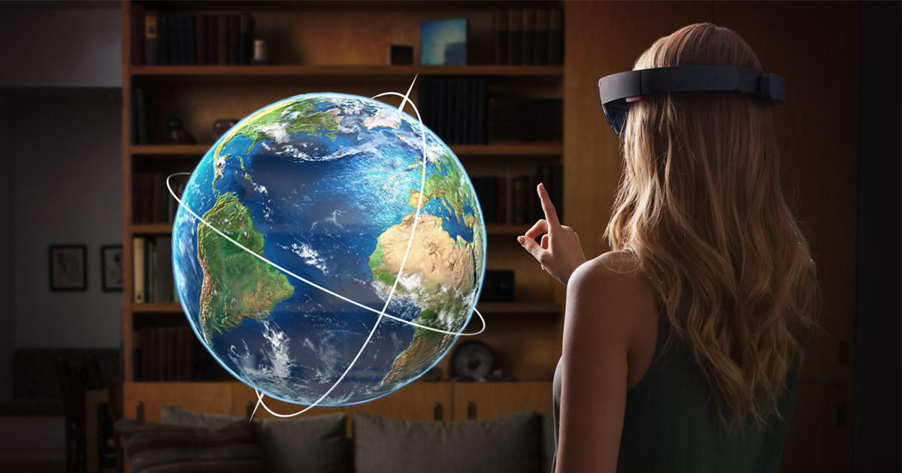
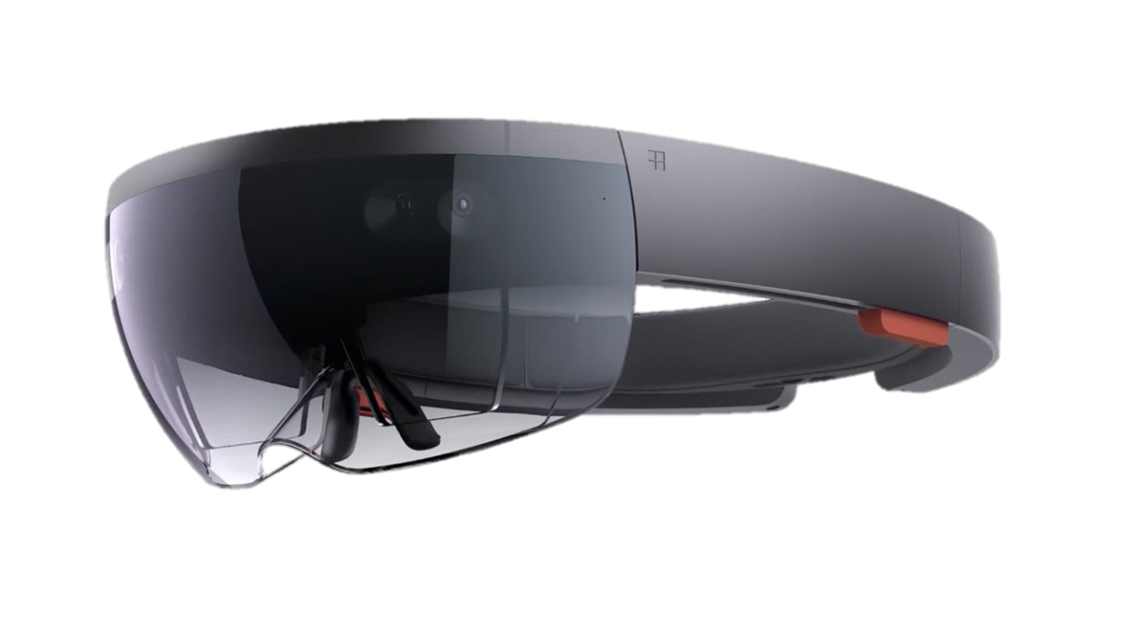
Holographic lens
HoloLens is essentially a holographic computer built into a headset that lets you see, hear, and interact with holograms within an environment

Slide 25
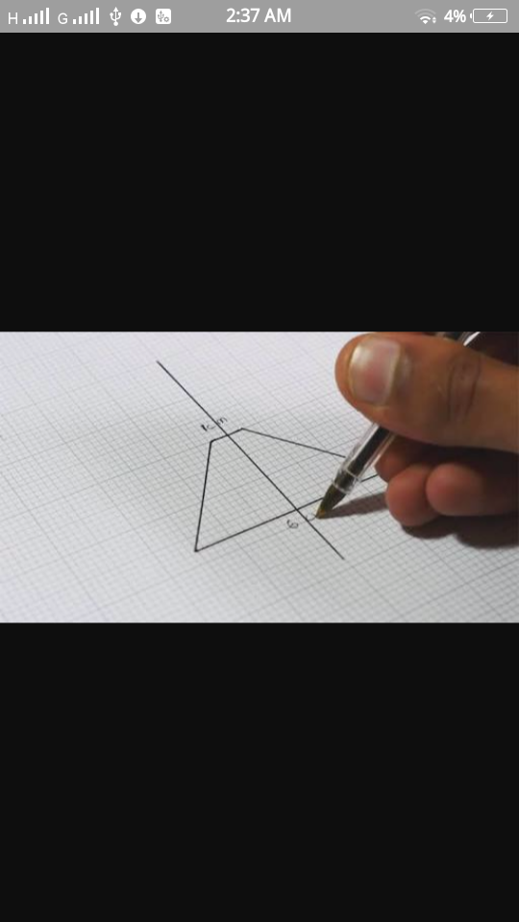
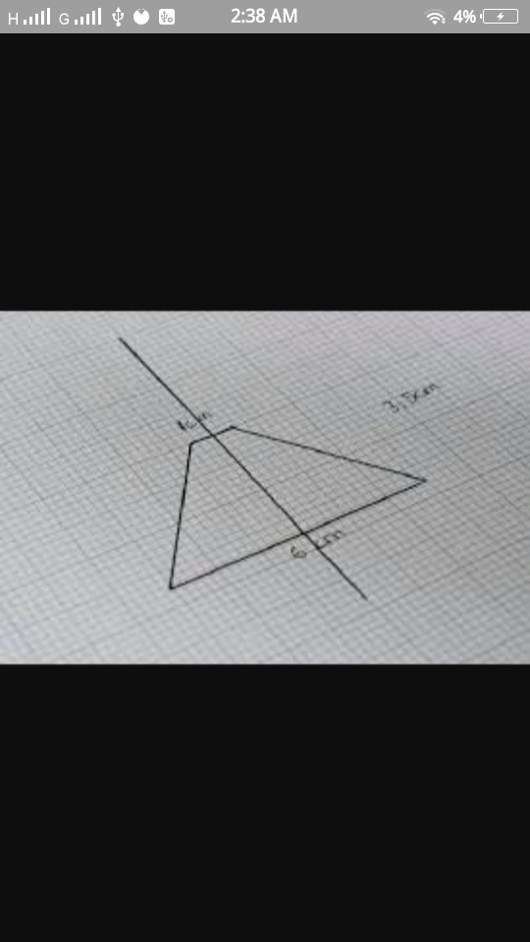

Slide 26
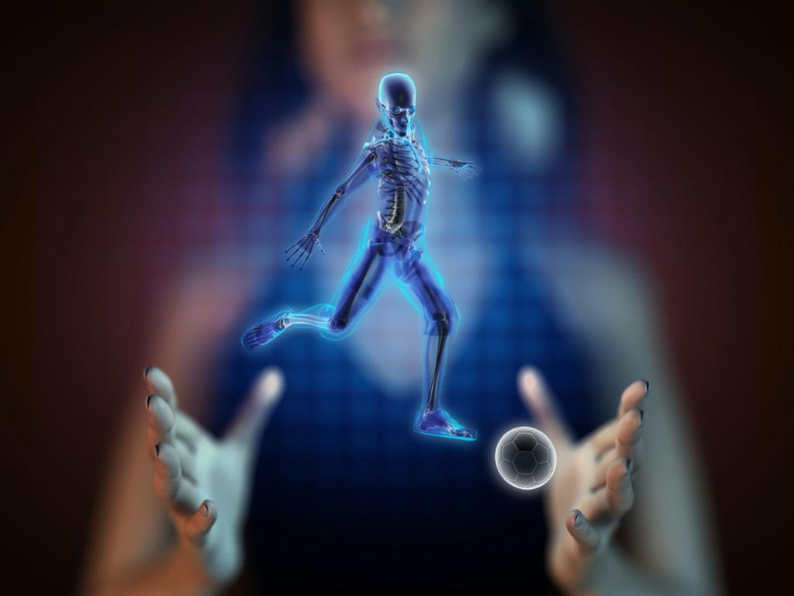
THANK YOU!!

